Slide 1
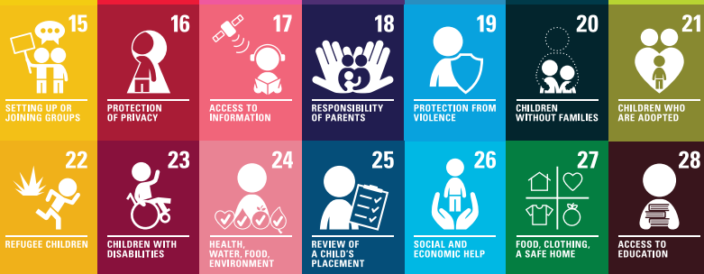
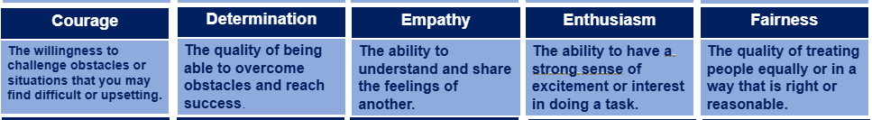
PSHE Revision Homework: Term 2
British Values
Democracy
Rule of Law
Individual Liberty
Mutual Respect
Tolerance
Notes:
Support: Give ways you can participate in democracy eg voting, standing for election, joining a political party, direct action, indirect action
Oppose: Voting system, turnout, Switzerland, role of media and social media

Slide 2
PSHE Revision Homework: Term 2
How do I revise? Use Look, Cover, Write and Check.
What will I need to revise? What the British Values are, the number and name of the UNCRC Articles, the Character Value names and definitions
What will I be getting tested on? Look at the Revision Homework schedule below. You will get tested in the next PSHE lesson.
Week 1 | Week 3 | Week 5 | Week 7 | Week 9 | Week 11
Courage UNCRC 15-18 Individual Liberty | Determination UNCRC 19-22 Democracy | Empathy UNCRC 23-26 Rule of Law | Enthusiasm and Fairness UNCRC 27-28 Mutual Respect and Tolerance | Revision of past homeworks for Powerful Knowledge Test | End of Term Powerful Knowledge Test in lesson
Notes:
Support: Give ways you can participate in democracy eg voting, standing for election, joining a political party, direct action, indirect action
Oppose: Voting system, turnout, Switzerland, role of media and social media

